Slide 1
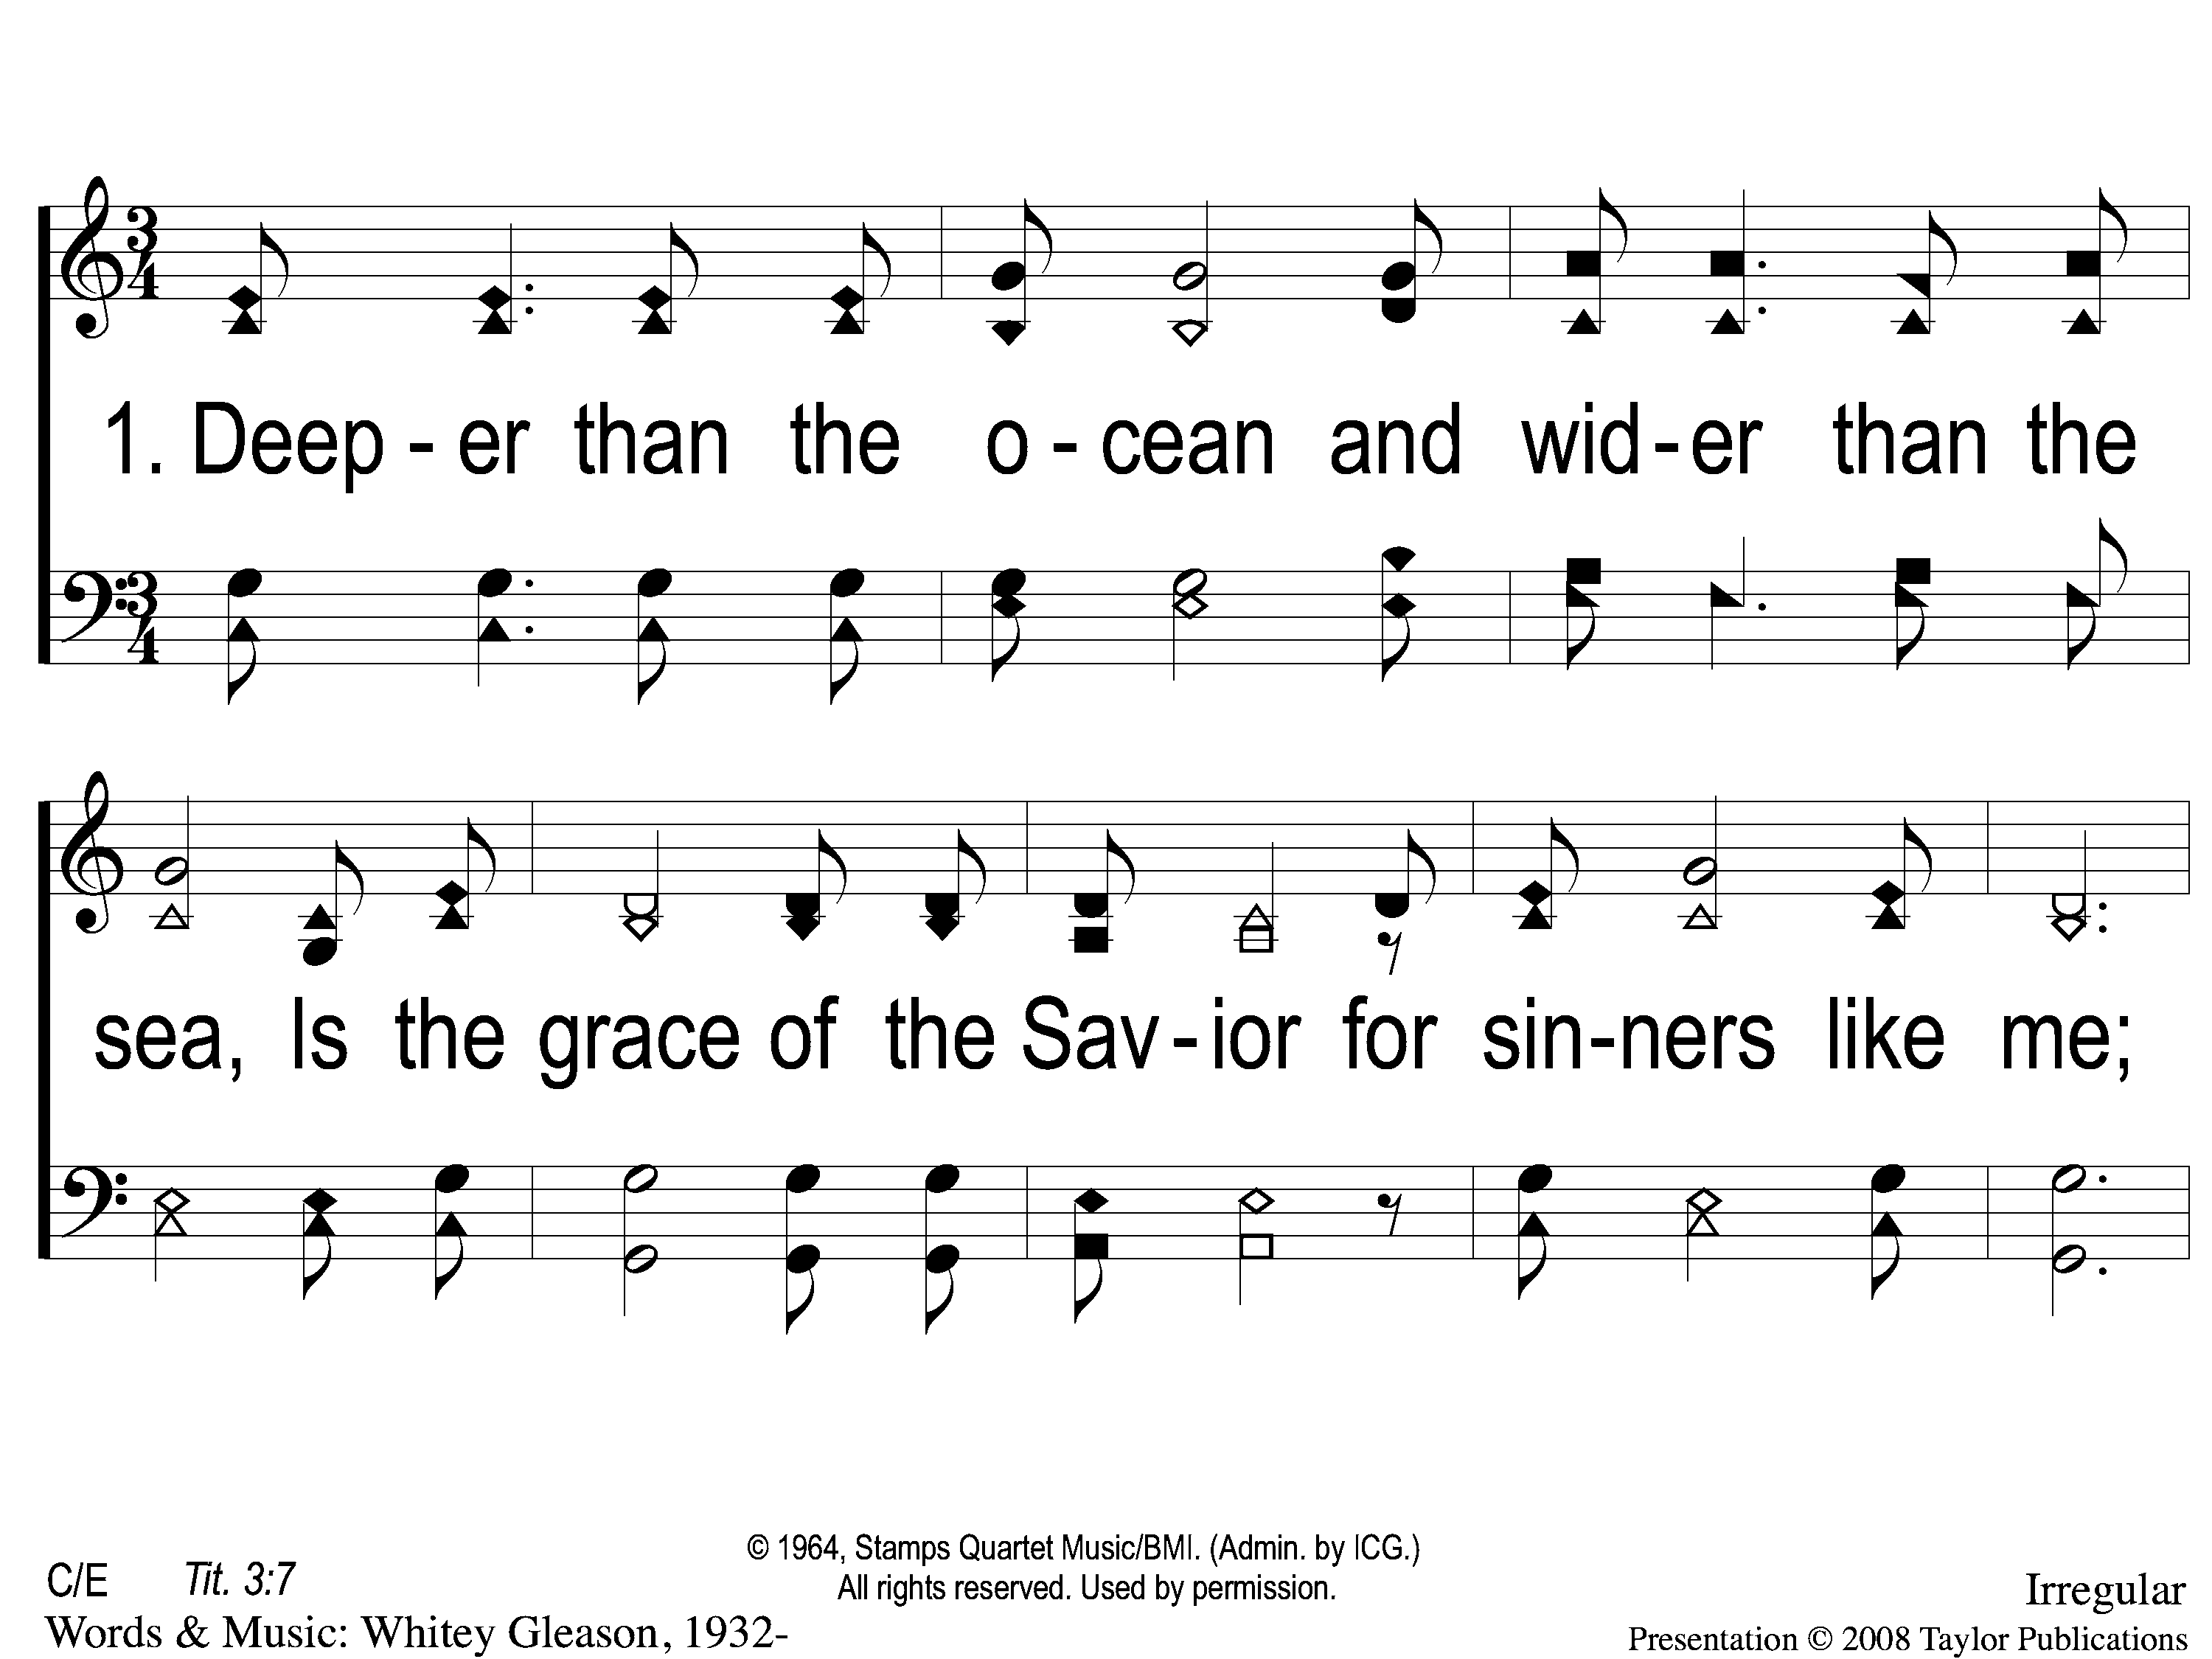
1-1 His Grace Reaches Me
His Grace Reaches Me
180

Slide 2
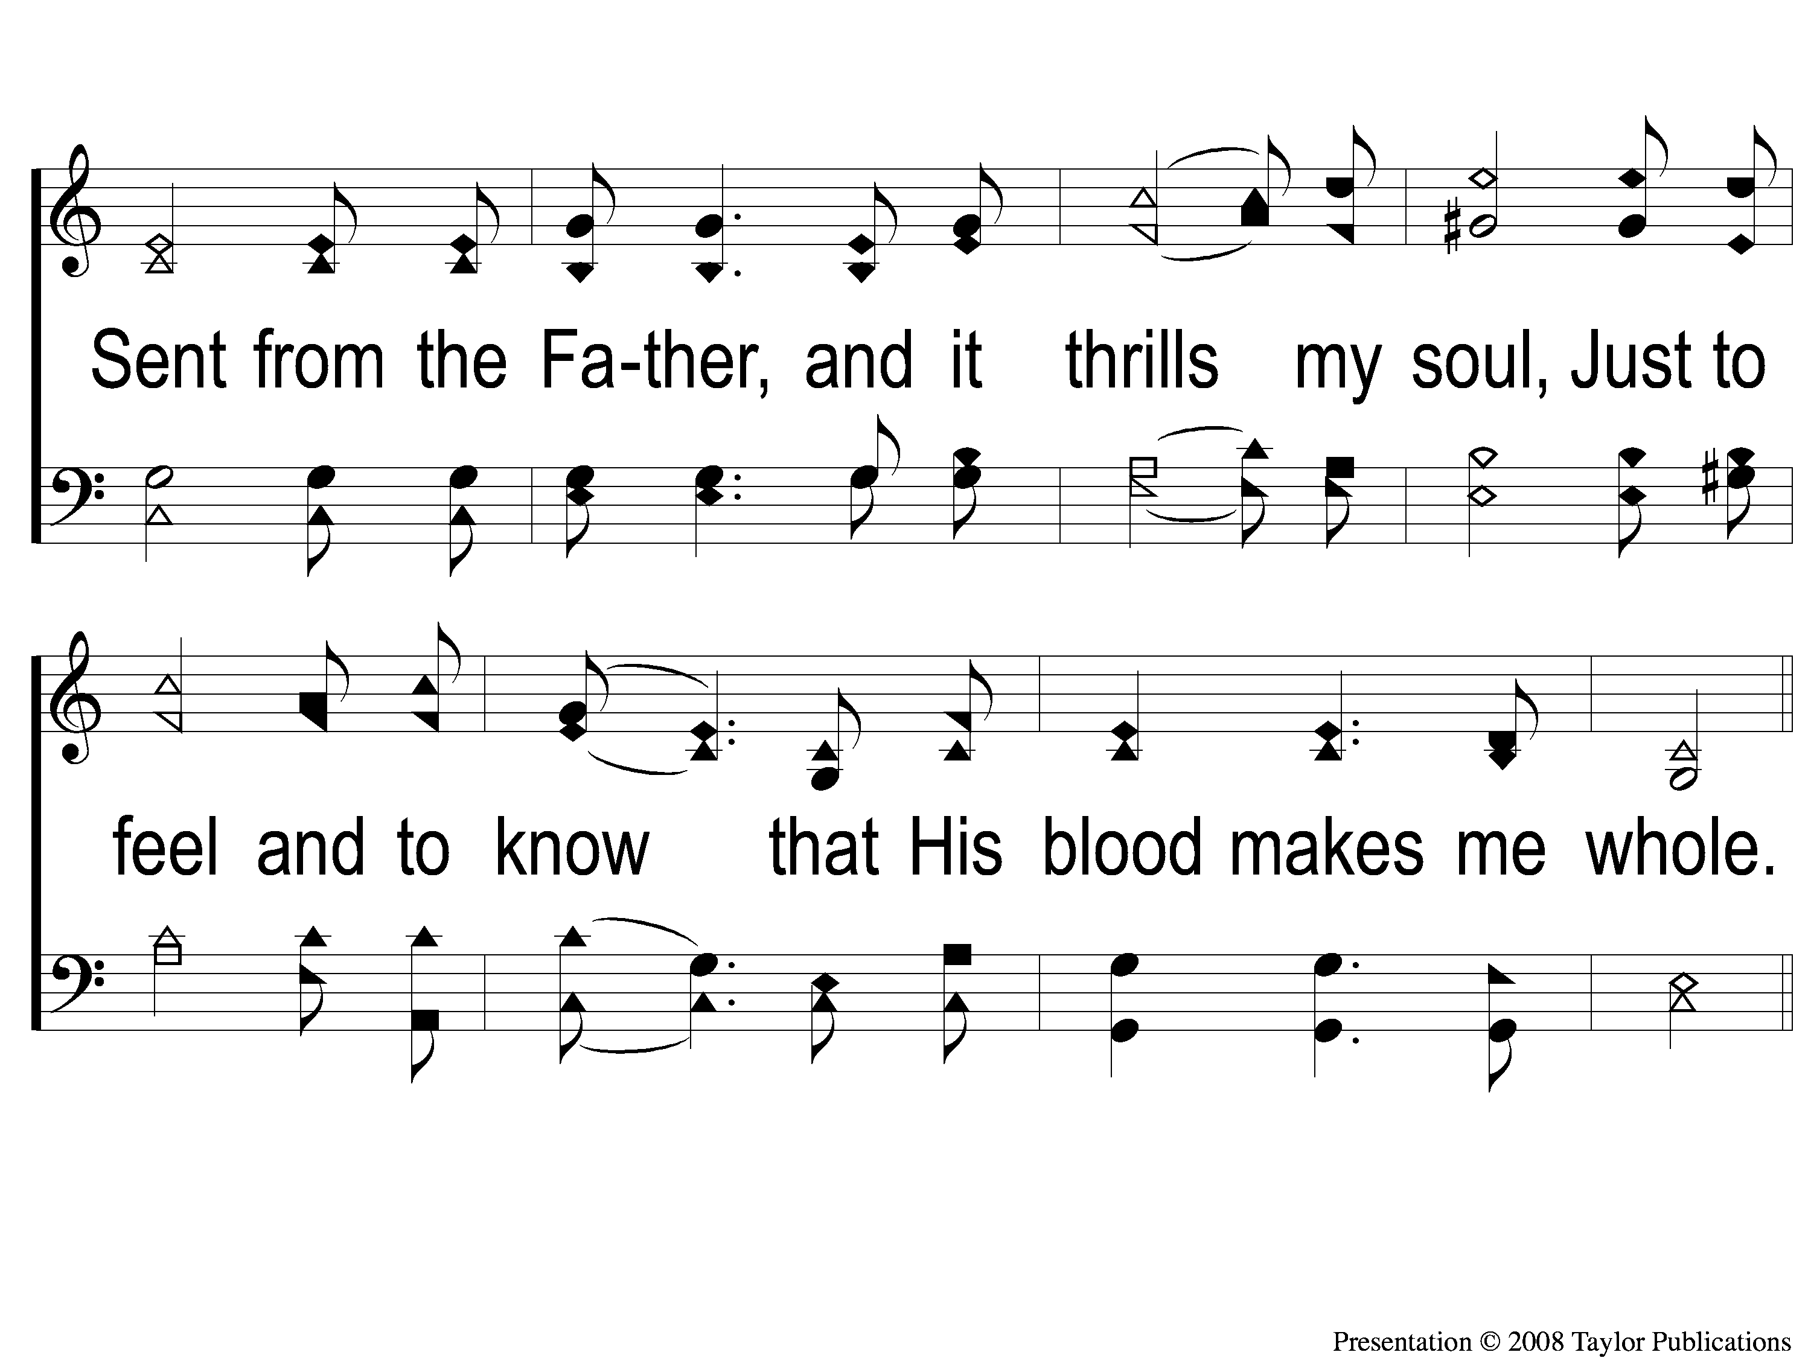
1-2 His Grace Reaches Me
His Grace Reaches Me
180

Slide 3
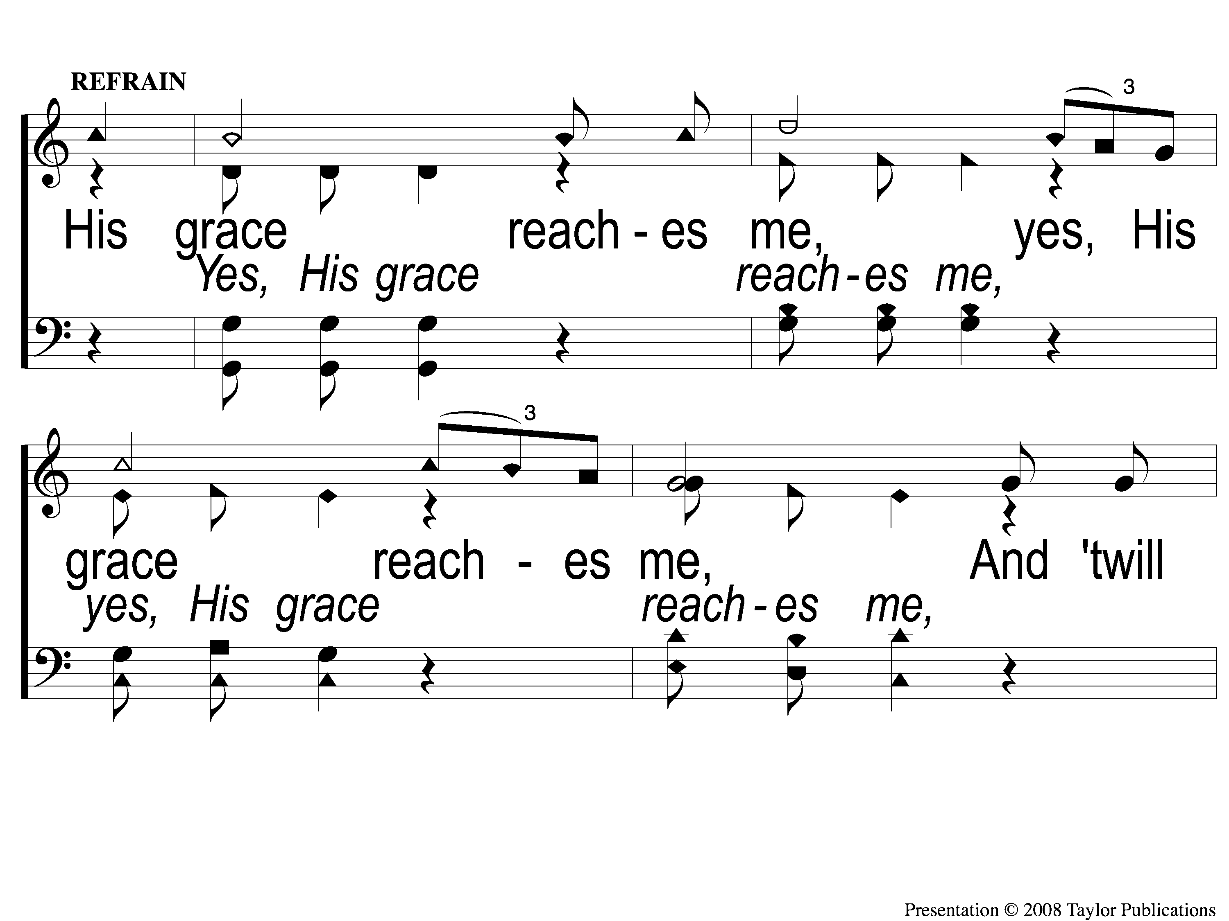
C-1 His Grace Reaches Me
His Grace Reaches Me
180

Slide 4
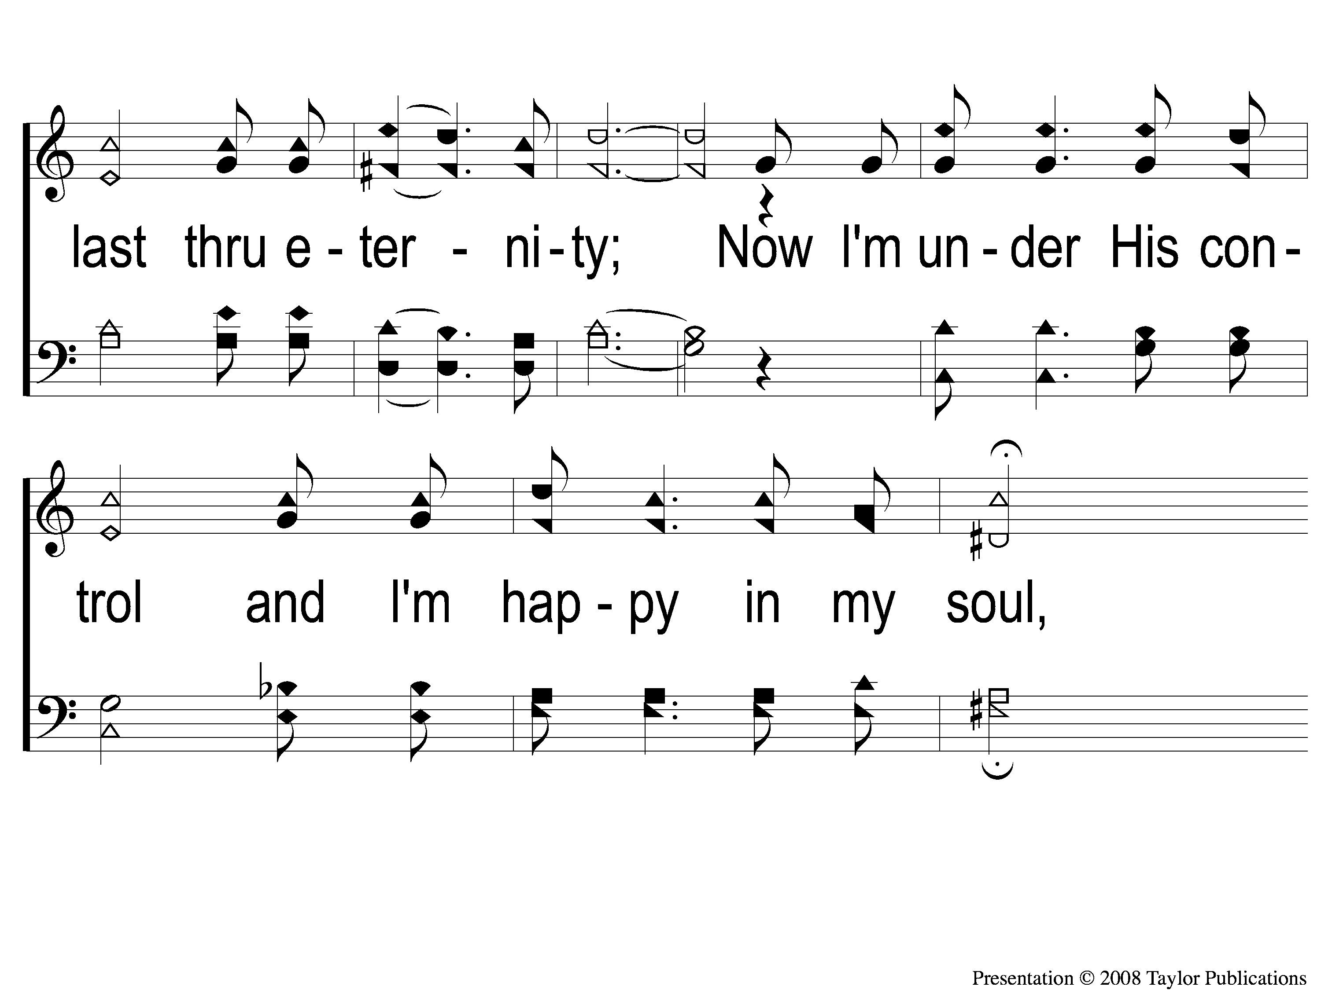
C-2 His Grace Reaches Me
His Grace Reaches Me
180

Slide 5
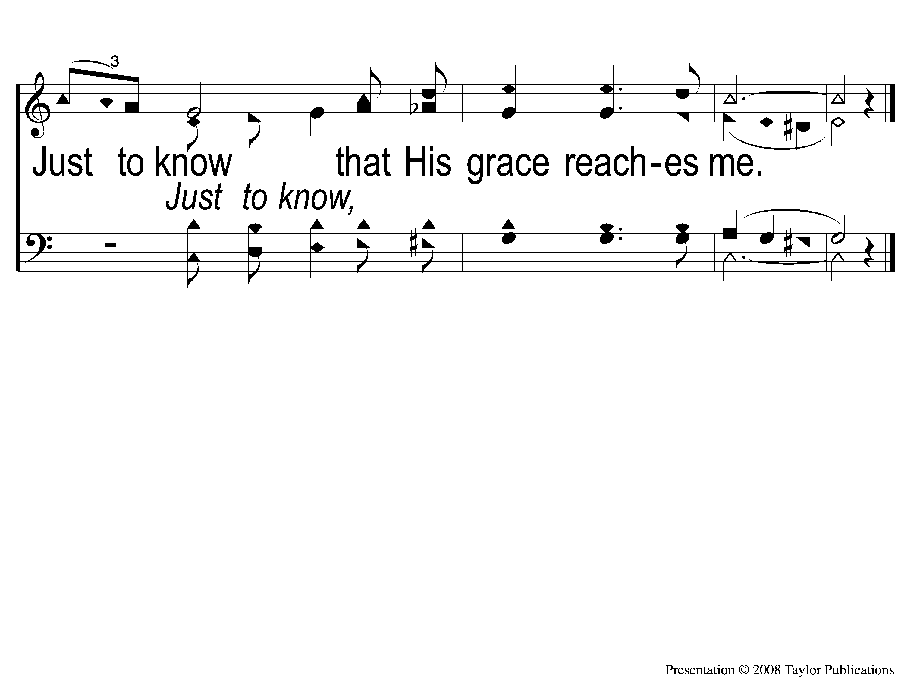
C-3 His Grace Reaches Me
His Grace Reaches Me
180

Slide 6
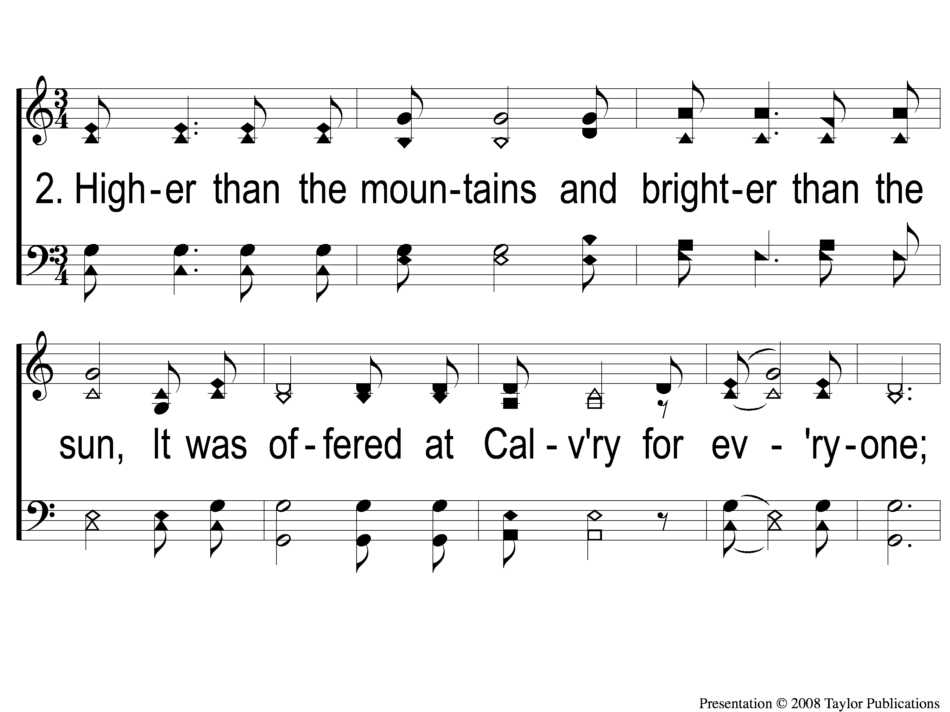
2-1 His Grace Reaches Me
His Grace Reaches Me
180

Slide 7
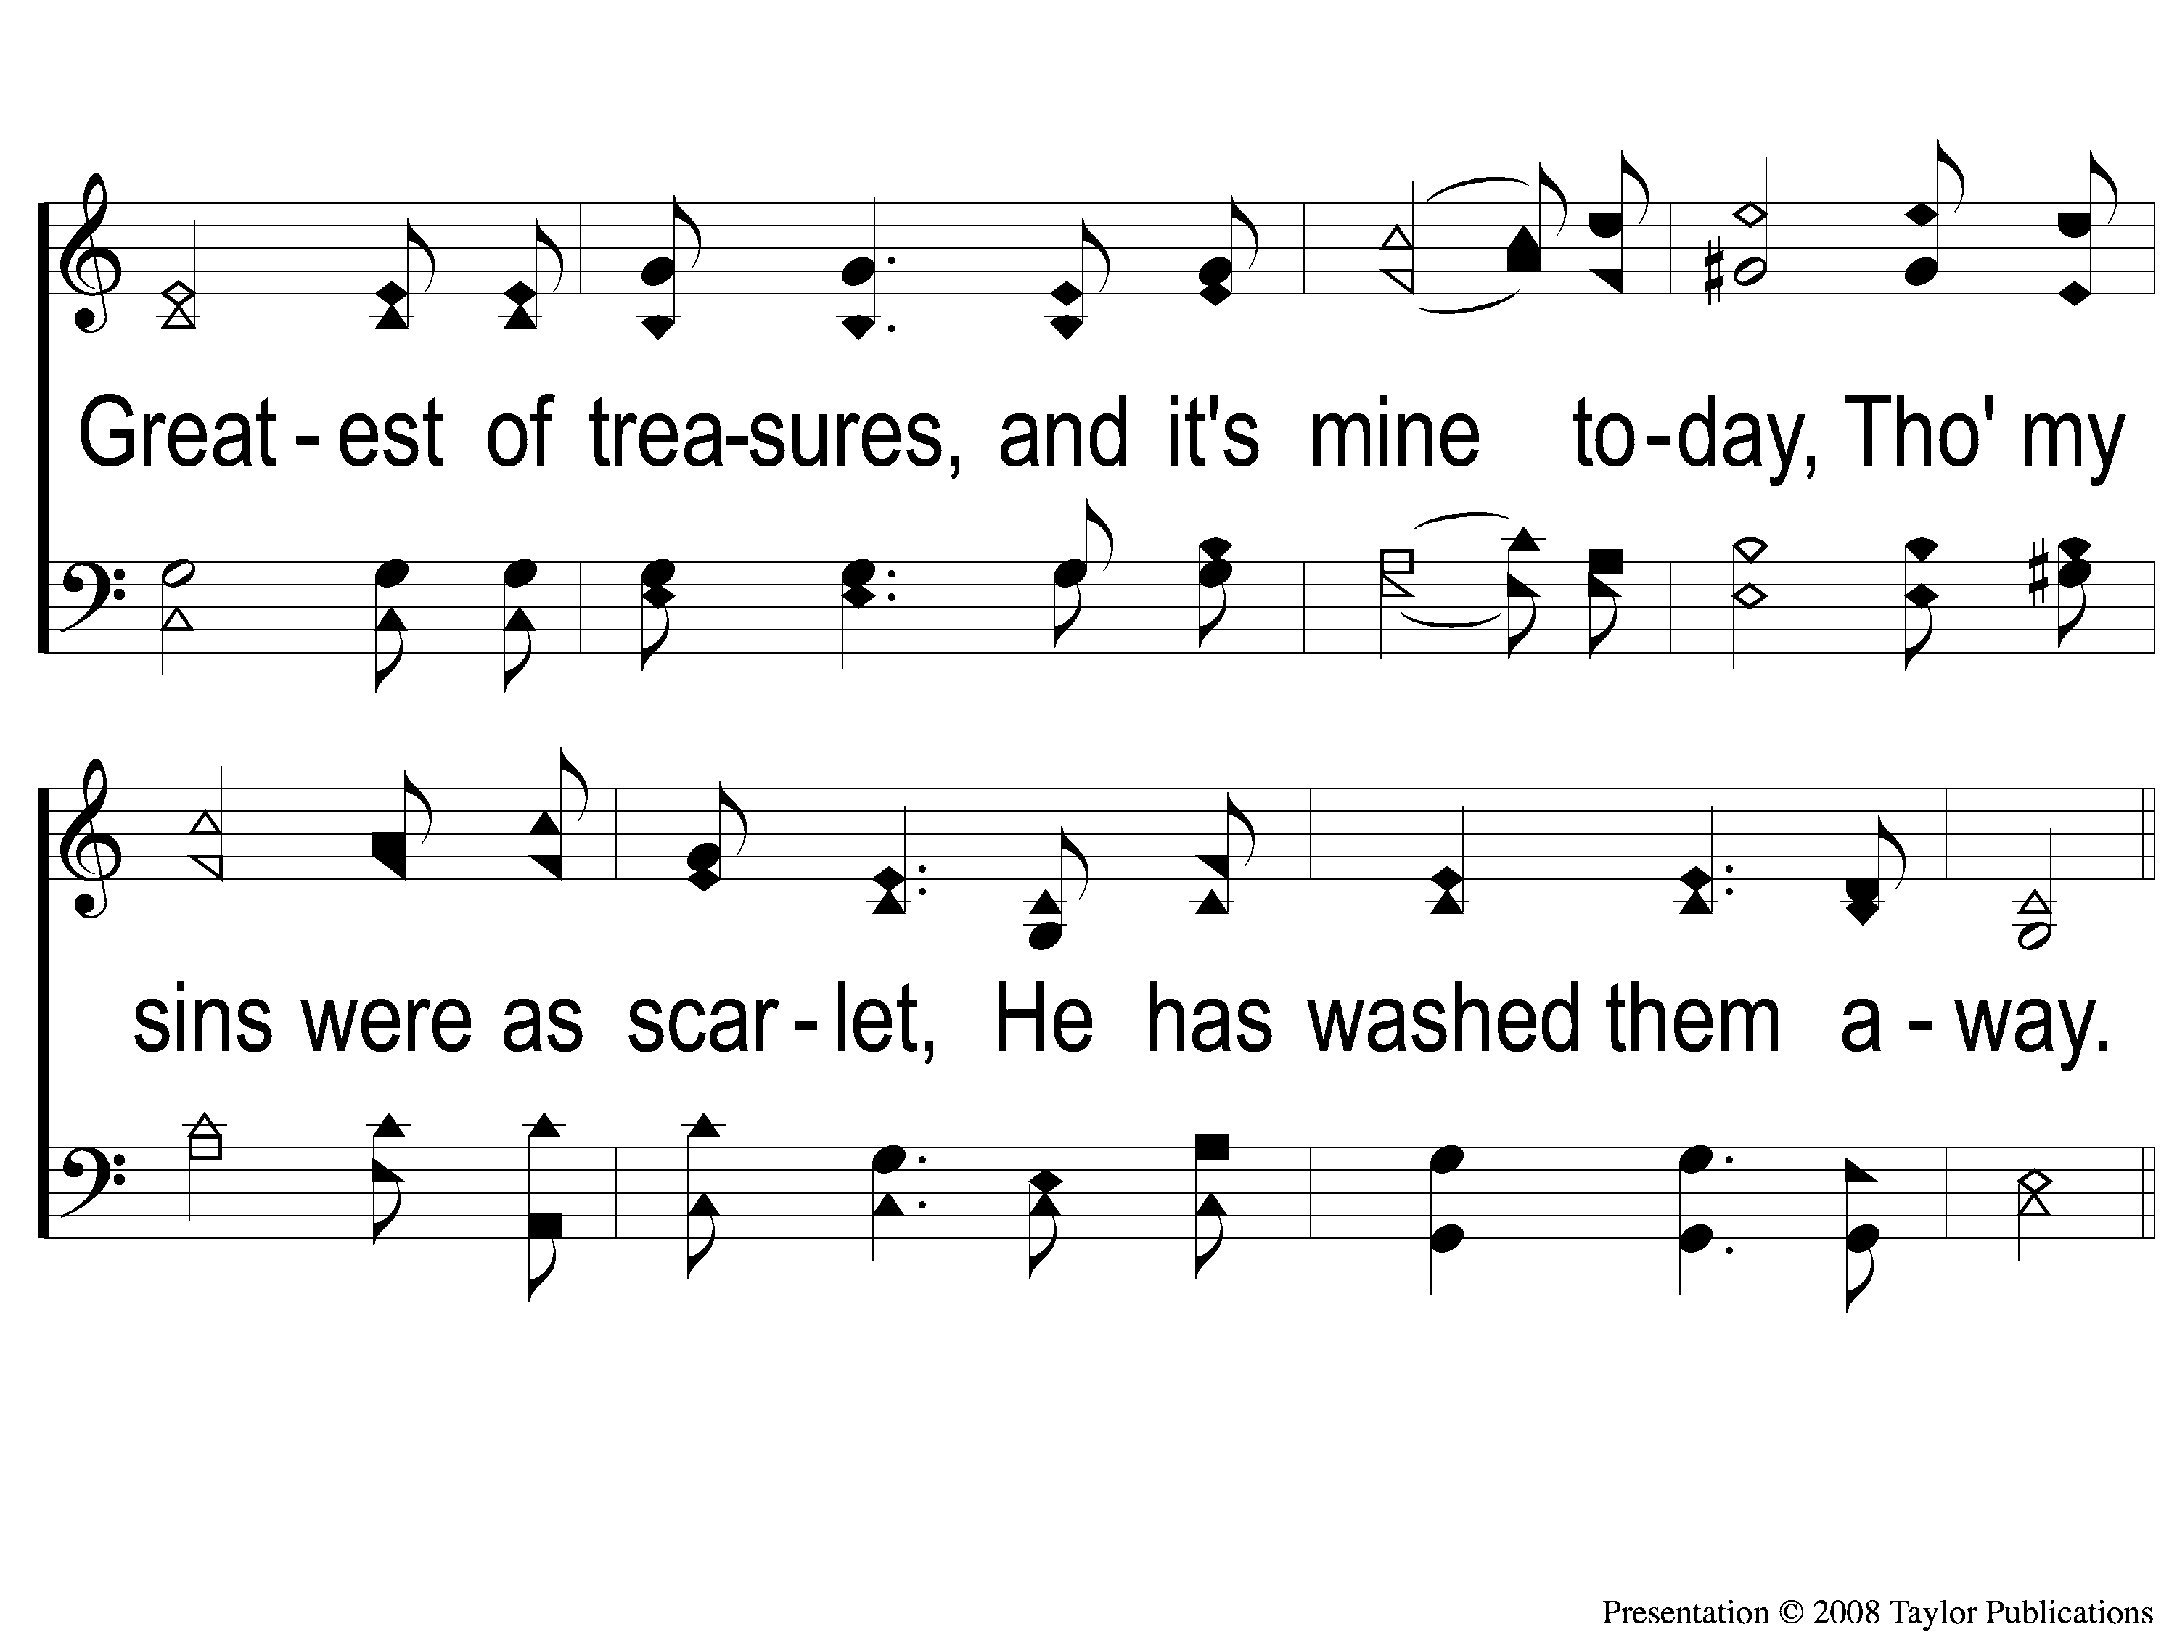
2-2 His Grace Reaches Me
His Grace Reaches Me
180

Slide 8
C-1 His Grace Reaches Me
His Grace Reaches Me
180

Slide 9
C-2 His Grace Reaches Me
His Grace Reaches Me
180

Slide 10
C-3 His Grace Reaches Me
His Grace Reaches Me
180

